Slide 1
US Distributional NTA – first steps and early results
Ron Lee, Gretchen Donehower, Michael Abrigo, Andy Mason
May 4, 2020
Workshop on Micro-NTA

Slide 2
Most estimates just done yesterday and today, here show early results
Various problems and distractions have delayed our work, so early work in progress – but still interesting!

Slide 3
Here is what we have now
All results are annual for 2006-2018, and will be extended back to 1981 soon.
All results now include college students, prison inmates and people in nursing homes (institutionalized population). New.
RESULTS
  Basic NTA, 2006-2018.
  NTA by education of head and by gender, 2006-2018.
  Distributions of yl, Soc Sec inflows, Total public cash inflows, Pub Educ inflows 2006-2018. (But not yet cons or wealth).

Slide 4
Where we want to go
Distributions of individual NTA consumption, reflecting public and private transfers. Compare to distributions of individual primary incomes. Levels, trends.
Distributions of wealth including transfer wealth, comparison to distributions without transfer wealth. Trends, comparison to levels and trends of inequality in bequeathable wealth, Piketty, Saez, Zucman.
Projections of future labor force by education and its capacity to support future elderly. Concerns in US because high proportion of children is born to parents with low education and low income.
  Fertility and mortality by Educ
  Education of kids by education of parents

Slide 5
Where we want to go (cont.)
Projections of saving and asset accumulation by education
Capital intensification?

Slide 6
Gretchen will continue…

Slide 7
The Big Issues
Large institutionalized population that consumes a lot of health care
  Data on covariates for that population are hard to come by
  Lots of assumptions about their spending
Two surveys (Consumer Expenditure Survey, Current Population Survey)
  Full distributions require linking survey microdata, not just averages
Health care
  Administrative data is available by age and sex, need to add a third and fourth survey to incorporate more covariates?
Survey items changing over time

Slide 8
The Little Issues
College & University Expense
  I get overall profile from enrollment rates at different types of institutions and tuition at those institutions
Public education
  Right now it’s just enrollment, I can add state-level variation in per pupil spending, but is that enough?
Various other items

Slide 9
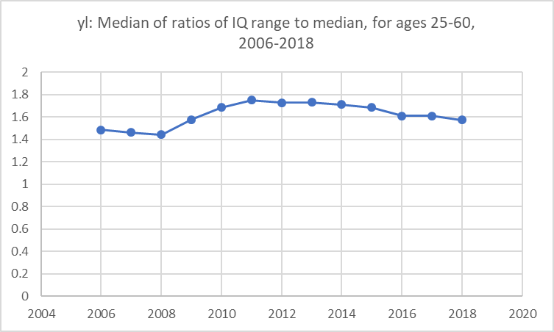
Labor income inequality over time (median of IQ/Med by age)
Inequality is flat 2006 to 2008 (March).
Inequality rises rapidly after Recession hits in July of 2008, rising until 2011.
Then very slowly declining but still greater than pre-recession.
Great recession

Slide 10
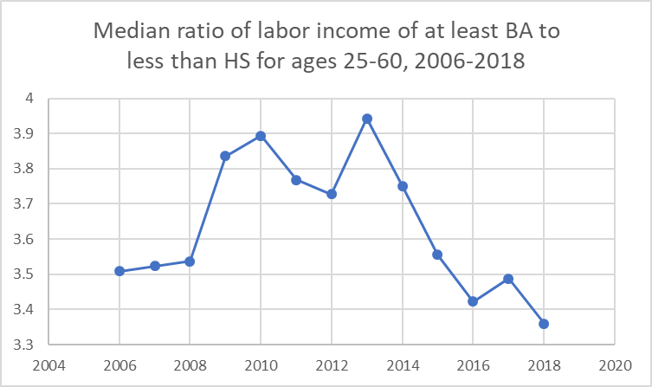
Ratio of labor income for college degree to less than high school
The advantage of college degree relative to less than high school jumped when recession hit.
Stayed high for years, but then plunged as labor market got tight and unemployment dropped to 5.6% in 2014.
Now low education workers are doing better than before recession.
Great recession

Slide 11
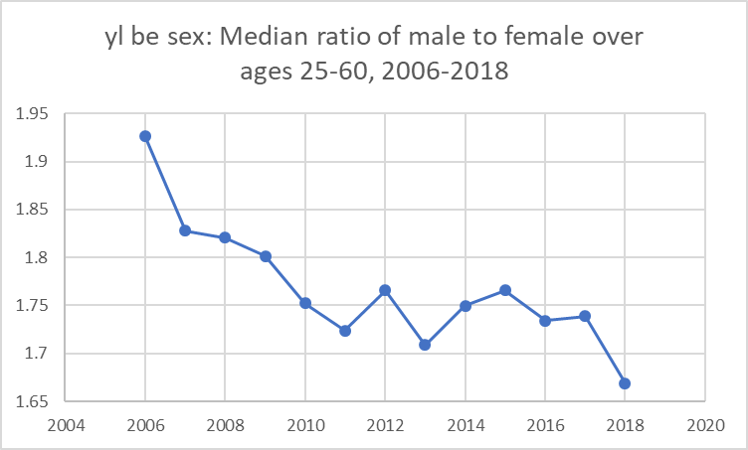
Ratio of male to female labor income dropped throughout
Lower in 2018 than in 2006
Seems unrelated to recession
Still two thirds higher for men.

Slide 12
Comparison to d’ALBIS & BADJI
Their analysis is more complete and their measures are different, but still some comparison of inequality in labor income within age groups is of interest.
Differences in measures
  Our yl is pretax; closest to us is their “Gross Inc” after social contributions but before other taxes.
  They calculate gini coefficients, decile shares, and quartile shares by age; we use Interquartile Range divided by Median Income at each age (problematic when median is low or zero, and tails of distrib have little effect).
  Their dates are 1996-2014, ours are 2006-2018.

Slide 13
Their results and ours – for now; hope to be able to compare more in future.
They find incomes became more unequal except ages 50-64.
We also find increasing inequality, but also an 8% increase in inequality at ages 50-64 by our measure (IQ/Med).
They find hump shaped inequality for gross income with inequality higher in the middle working ages.
We find inequality flat from 25 to 50, then rising steeply.

